Slide 1


Voltage, Ohms, & Amperes

Slide 2
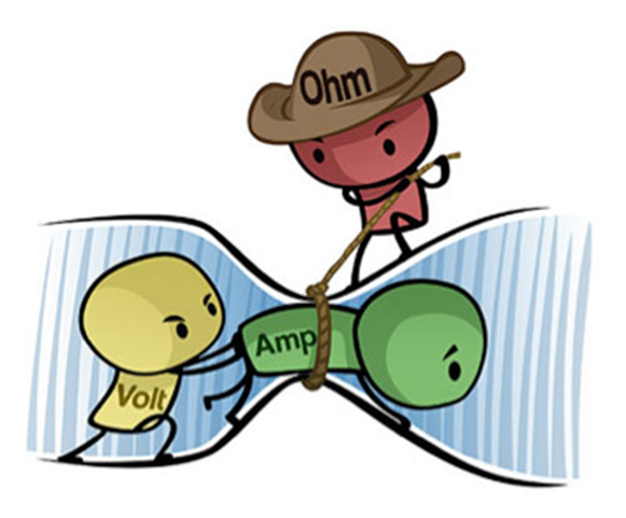
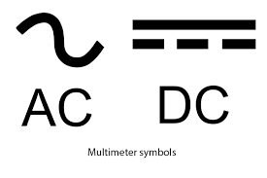
Voltage/Volts

Slide 3
Voltage/Volts

Slide 4

Ohms

Slide 5
Ohms

Slide 6
Amperes/Amps
A

Slide 7
Amperes/Amps
A

